Slide 1
ARIA Classrooms
Future Reality Powered with AI
https://aria-classrooms.web.app/

Slide 2
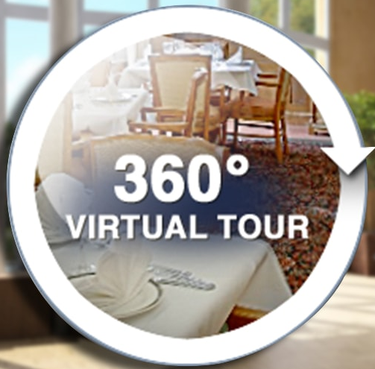

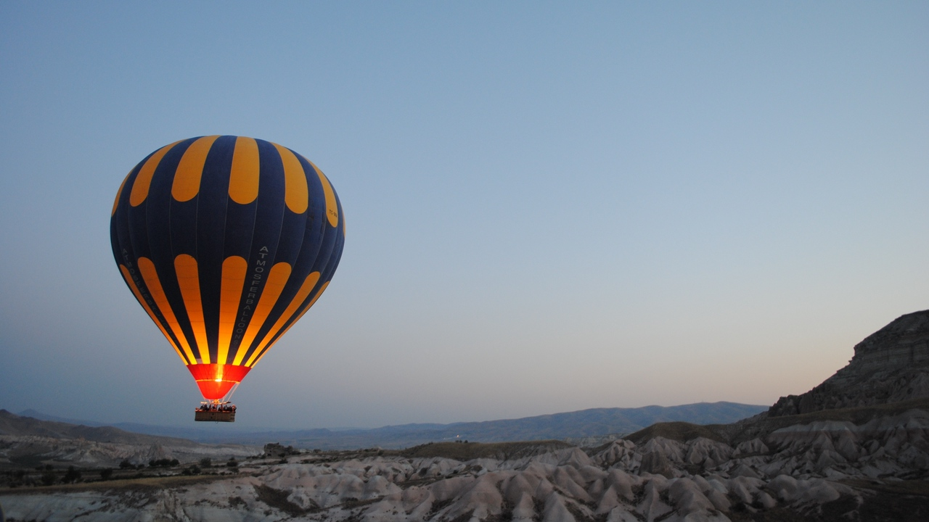
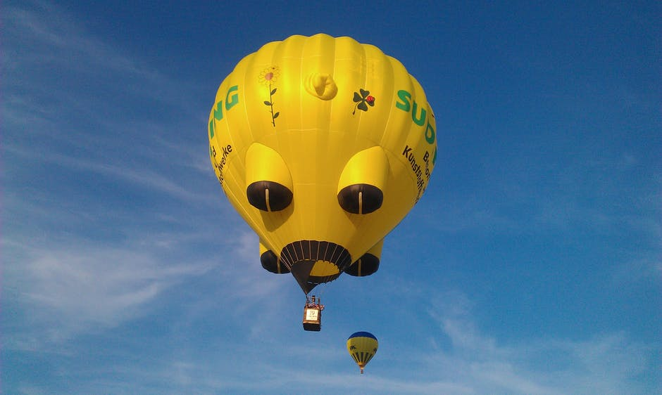

Future Reality + AI Assistants.
Most immersive experience
Aria Classrooms are tailored AI product built on Augmented Reality, Virtual Reality to help users learn more effectively.
Metaverse is next big thing in the internet and ARIA is the bridge to it.
https://aria-classrooms.web.app/

Slide 3
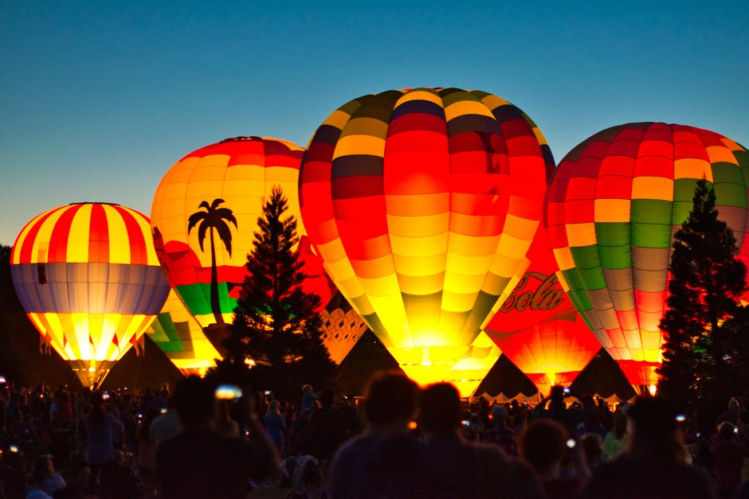


Our Motivation.
Reality experience now enhanced with AI
Future Reality
AR / VR / XR / MR
Strong & Advance
Language Model AI Bots
open sourced with A frame.
Powered by Advace AI/NLP
We use open source library A frame and built most immersive experience virtual tours
We use most advance and reliable azure services for building AI assistant.

Slide 4



ARIA Classrooms
Affordable AI
ARIA has mainly three parts
metaverse
Learn Anything
3D Space
ARIA AI Assistants
Future of learning is here. We can remove long held obstacles in education
Immersive 3D space with handling 3D Models with AI Assistants.
Advance and effective Language understanding AI voice assistants
High Performance
Innovatife & Creative
Give Smart Solution

Slide 5
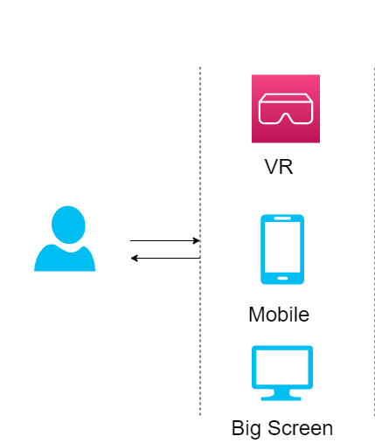
ARIA Naration Bot Architecture
ARIA
Moderns problems needs modern solutions.

Slide 6
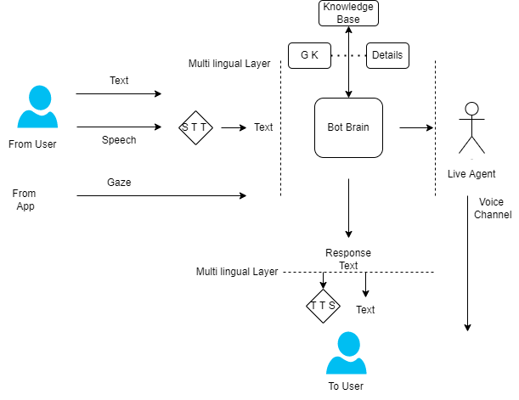
ARIA Naration AI Bot
ARIA Bot
Most advance AI Voice / Chat Bot powered by Microsoft Azure
Note: Actual architecture may slightly change w.r.t different azure services and capabilities.

Slide 7
Industries.
Most advance reality experience Improves Business
Education Tech
Metaverse
Health Tech
In-depth immersive product visualization and guiding. Virtual Field trips.
We create classrooms for Metaverse
Future of operations and surgeries
Highly innovative
Innovatife & Improvise Banking
Health Care Innovation

Slide 8

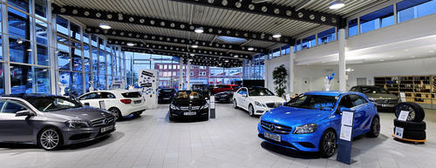





Used by
Students
Employees
Can learn more effectively
Can learn very fast
Guided Virtual Tours, Collaborative Tours ( ARIA together )
HR policies, Office Walkthrougs etc
Internet User
Metaverse User
Enriched Understanding
ARIA Study, ARIA Narration
Any information in internet can be consumed more effectively
Schools, Students, Personalization

Slide 9




About Us.
Team
Transform Learning
with Immersive VR.
The all new Metaverse is the future of business, We are just the stepping stone into it. Virtual Reality is made much immersive with our AI powered bots
Passionate Team
Experienced developers
Built with open source
5
50
Customer
Validation done
Finished Project
Happy Customers

Slide 10
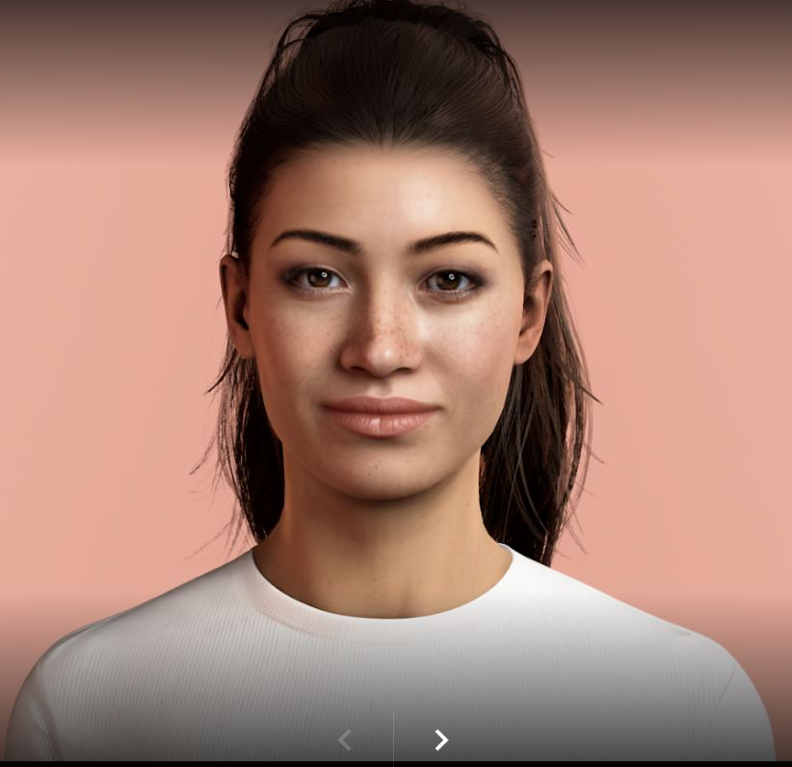
Aframe / Uneeq
Open source and Free
Used aframe open source framework for Virtual Tours
Human Digital Representations
AI Bot
Build Strong Apps
From scratch– to till now.
Azure bot services
AI bot will be built using microsoft azure services
New 2022
Azure
Holo lens

Slide 11


Vission.
VR + AI = ARIA
Passion meets people
Beautiful and immersive assisted future reality
Virtual Reality apps are eagerly waited services for many business to acquire and utilize
Virtual Tours
Most affordable way of generating 360 images
AI Bot
Brainstorming
Evolve the solution
Brainstorming
Most powerful and multilingual for the world.
We strived to make sure the products are built from scratch
With power of Azure services, AI Assitant got much powerful
Evolve the solution to world

Slide 12
Mission.
Affordable AI
To bring business to next generation of AI and VR.
metaverse
Affordable
Reliable
Immersive VR
Most affordable Learning
Most reliable
AI assitant makes much more effective
High Performance
Innovatife & Creative
Give Smart Solution

Slide 13





Super Team.
Modern
Team
Yeshwanth Sai
Kiran Kumar
Founder and developer
Developing Skills
90%
Developing skills
90%

Slide 14
About ME.
Strong leadership
Yeshwanth Sai
Founder and Developer
Modern
“
Always deliver more than expected.
”
Marketing
80%
Selling
95%
Team Building
90%

Slide 15
World wide languages. (Scale at Ease)
Russia
Europa
Modern
Engish
Asia
Africa
Australia
We can support 119 languages world wide

Slide 16
Thank You.
Virtual Reality meets Artificial Intelligence
ARIA

